Slide 1
SVM
Byte Academy

Slide 2
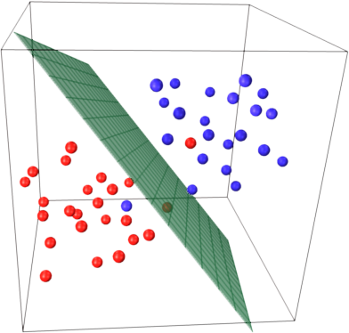
Maximal Margin Classifier
What Is a Hyperplane?
In a p-dimensional space, a hyperplane is a flat affine subspace of
dimension p − 1.
I.e
1) In 2D line is hyperplane.
2)In 3D hyperplane is a flat two-dimensional subspace.

Slide 3
Hyperplane Equation
1)for 2D setting
β 0 + β 1 X 1 + β 2 X 2 = 0
2)For n-Dimensional setting:
β 0 + β 1 X 1 + β 2 X 2 + . . . + β p X p = 0

Slide 4
Hyperplane Equation
β 0 + β 1 X 1 + β 2 X 2 + . . . + β p X p = 0. (Lies on hyperplane)
β 0 + β 1 X 1 + β 2 X 2 + . . . + β p X p > 0.( one side of hyperplane)
β 0 + β 1 X 1 + β 2 X 2 + . . . + β p X p < 0. (other side of hyperplane)

Slide 5
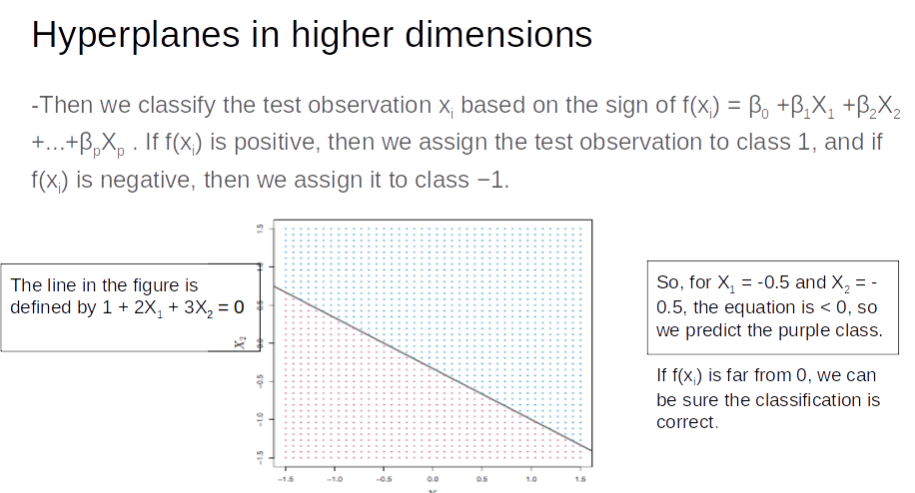

Slide 6
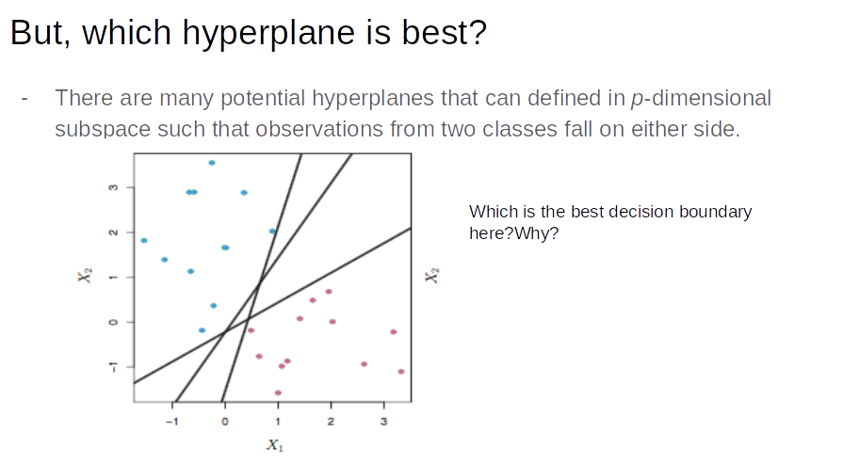

Slide 7
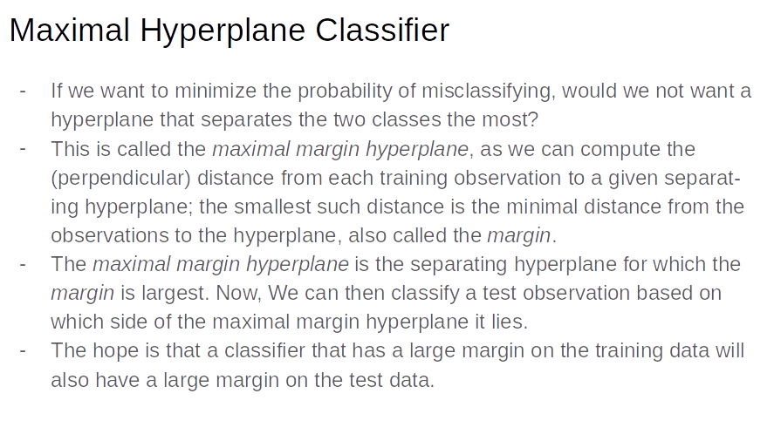

Slide 8
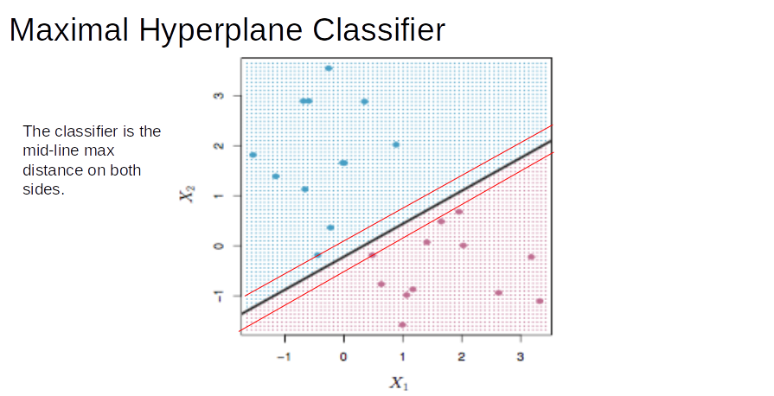

Slide 9
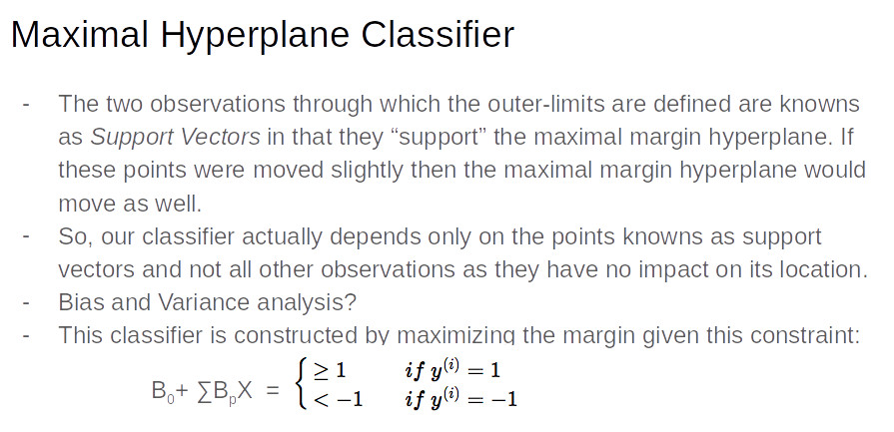

Slide 10
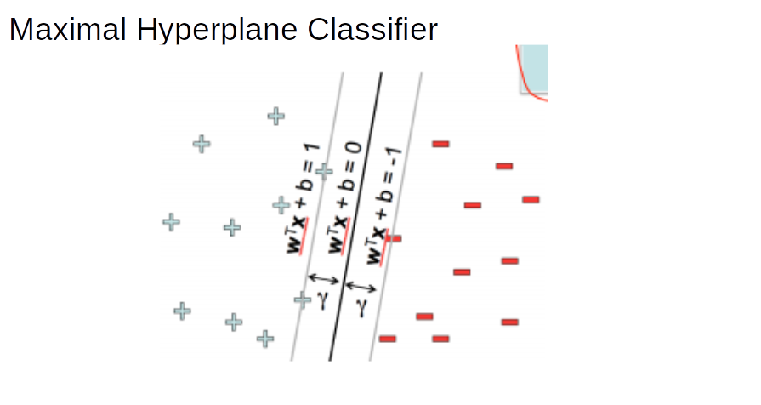

Slide 11
Solve hyperplane equation
W’ * X_pos+ B=1 -----------(1)
W’ * X_neg+B=-1 -----------(2)
Adding eqn subtract(2) from (1)
W’ * X_pos-W’ * X_neg=2
||W|| =length of W

Slide 12
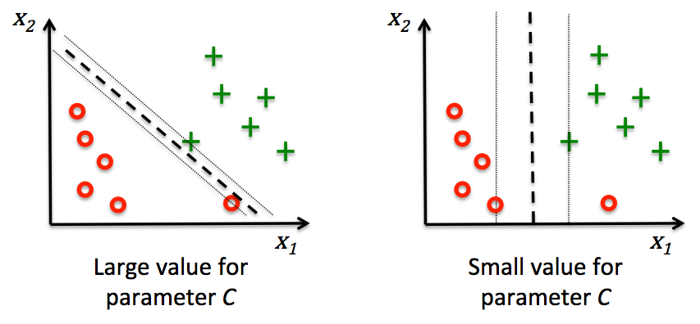

Slide 13
C tuning
variable C , can control the penalty for misclassification.
Large values of C correspond to large error penalties.
whereas we are less strict about misclassification errors if we choose smaller values for C .
parameter C to control the width of the margin and therefore tune the bias-variance

Slide 14
svm
The support vector machine (SVM) is an extension of the support vector
classifier that results from enlarging the feature space in a specific way,
using kernels

Slide 15
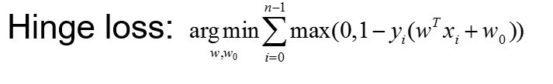
When the classes are well
separated, SVMs tend to behave better than logistic regression; in more
overlapping regimes, logistic regression is often preferred.

Slide 16
Resources
SVM Video
Irish dataset with kernel

